Slide 1

Database Management Project Presentation

Slide 2
Group - 18
Team Database
Shahriar Amin Ronok – 2031361
Tushar Basak – 2022315
Md. Golam Saqlain – 2030404
Ikterab Yazda – 1910970
SM Tanzim Tuhin – 2022302
Monjurul Hoque Sharnav – 1821422
Ashir Abdal Ravee - 2020646

Slide 3
Introduction
A database management system designed to help teachers, administrators, department heads, and deans manage and track the academic progress of students. With the ability to automate administrative processes, such as grade reporting and attendance tracking, this system enables early identification of academic difficulties and ensures each student receives the assistance needed to succeed. Our major goal is to provide a thorough platform for tracking and evaluating student performance and growth, allowing instructors to enter and record grades for various tasks, tests, and examinations, while also enabling students to monitor their progress over time. With SpmsV4, relevant documents and data are stored in the database to evaluate the performance of stakeholders, and students have access to a variety of analytical data.

Slide 4


Slide 5
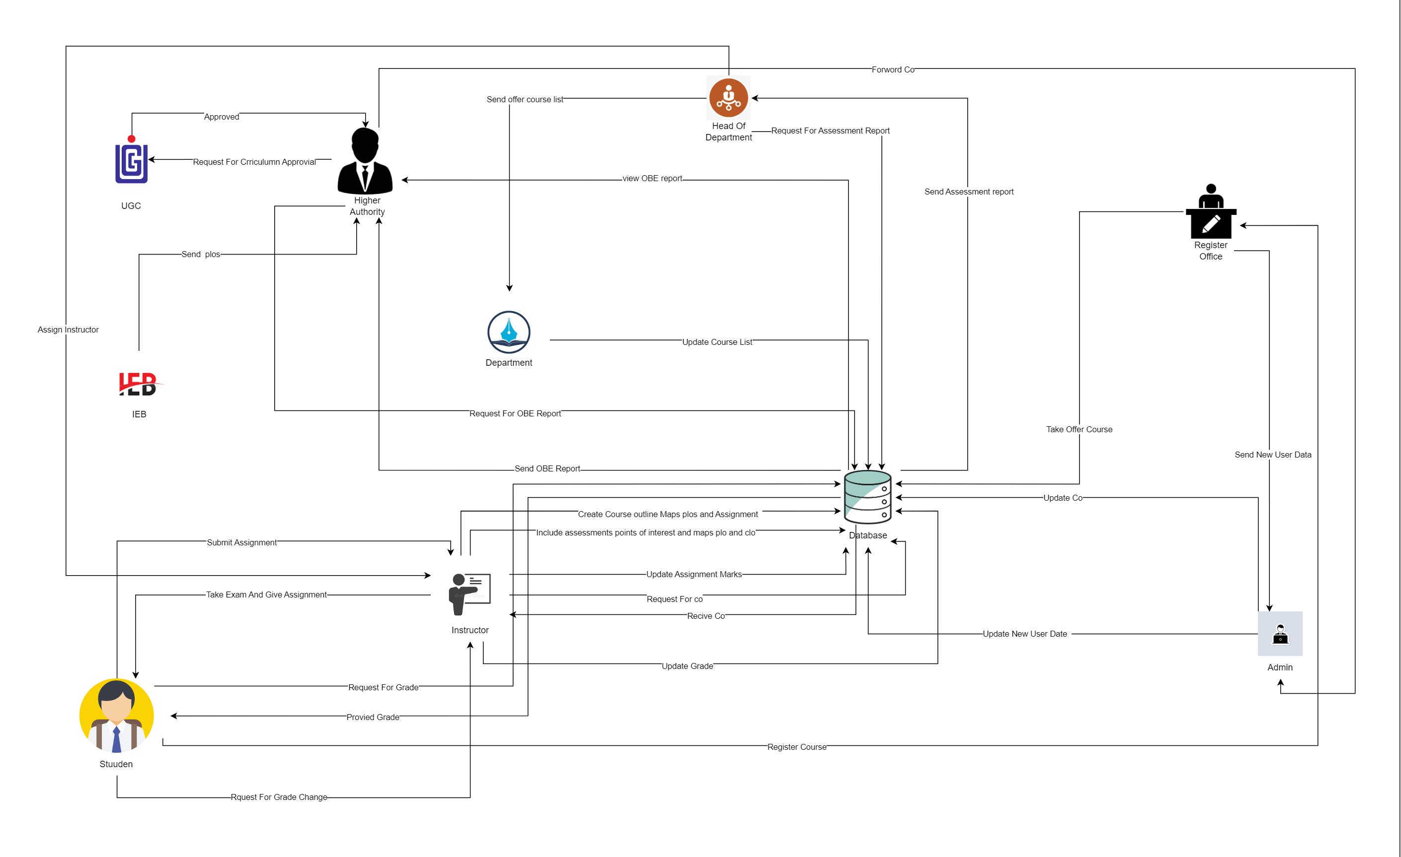
Rich Picture (Existing)

Slide 6
Existing Process and Six Element Analysis
Six Element Analysis -> Existing System
From Rich picture we identified 7 key processes:
Calculate Course Outcomes (COs) and Program Learning Outcomes (PlOs),
Record Student Evaluation Data,
Generate OBE Marksheet and Course Evaluation Report,
View result and download Transcript,
Create Student/Faculty/Staff accounts and insert/adjust necessary data,
Analyze student’s records, OBE Marksheets and Course evaluation reports over time tosee student performance pattern and
7. Review and grade change request.

Slide 7
Process Name | Stakeholders | Concerns(Problems) | Analysis( Reason of Problems) | Proposed Solution
Record student evaluation data | Faculty Member Student Administration | Project work, assignments, question papers, and answer scripts condition Giving and Receiving process Storage Problem | 1. The hard copies of answer scripts, project reports, and question papers that are being stored physically may get damaged or lost 2. The process of checking the answer script or receiving it and then recording it makes the process slow. 3. Physical storage maybe a problem for hard copies | The answer scripts and question paper are stored in the database, so it will be easy for him to find and search by student id. Which will be time reducing. Online submission of answer scripts saves time. Submitting online will be a good option for reducing storage problem
Generate OBE Marksheet and Course Evaluation Report | Faculty Member Student Administration | 1. Storing hard copies and soft copies becomes hard to manage | 1. Storing softcopies and hardcopies can become extremely difficult to manage when the organization has been operating for years. It also gets increasingly tedious to track documents to study student performance trends for a certain timeline. Updating information for a specific document would require tracking them, which in turn would make it harder to retrieve them and would require personnel to update various copies. | These problems can be fixed by maintaining these data tables in our database and giving necessary departments, offices, and outside parties (IEB) access via a user
Problem
Analysis

Slide 8


Slide 9
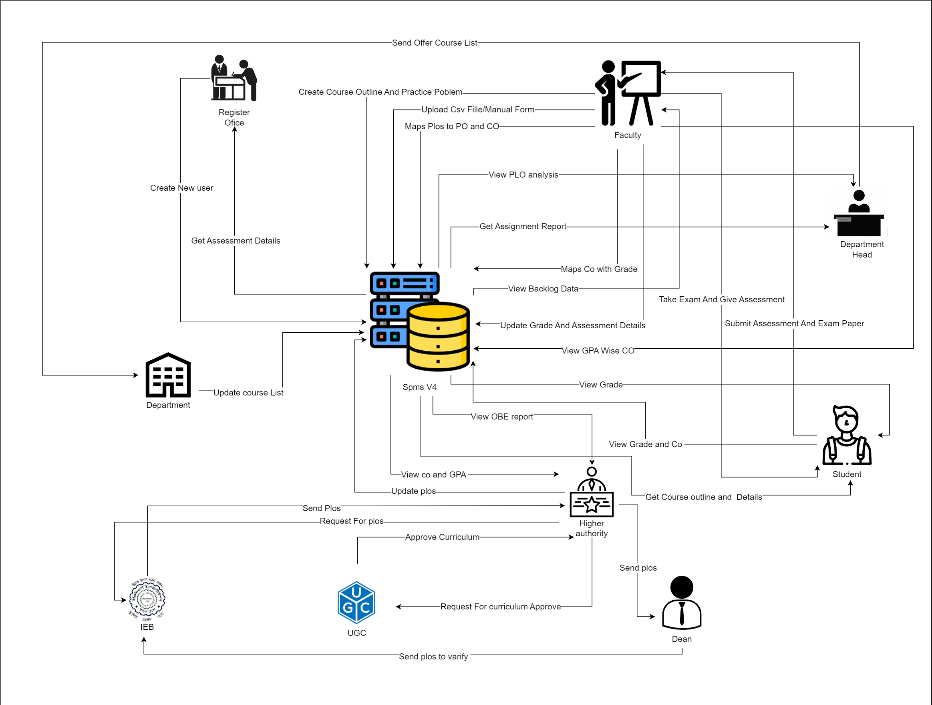
Rich Picture (Proposed)

Slide 10
Proposed Process Six Element Analysis
Proposed process and Six Element Analysis
From Rich picture we identified 10 key processes:
Make and deliver course outlines and lesson plans,
Statistics of student enrollment under VC / Dean / Head of Department supervision,
Include question sheets of quizzes, assignments and exams and evaluate replays of answer sheet,
Statistics of student performance patterns by GPA within any course,
Statistics of student performance patterns by GPA under faculty supervision,
Statistics of student performance patterns by GPA under VC / Dean / Head of Department supervision,
Course Outcome (CO) and Program Outcome (PO),
Program Learning Outcome (PLO),
Statistics of Courses, Programs, Departments and Schools CLO and PLO and
Statistics of average CLO / PLO of students under Department Supervisions of total number of attempts.

Slide 11
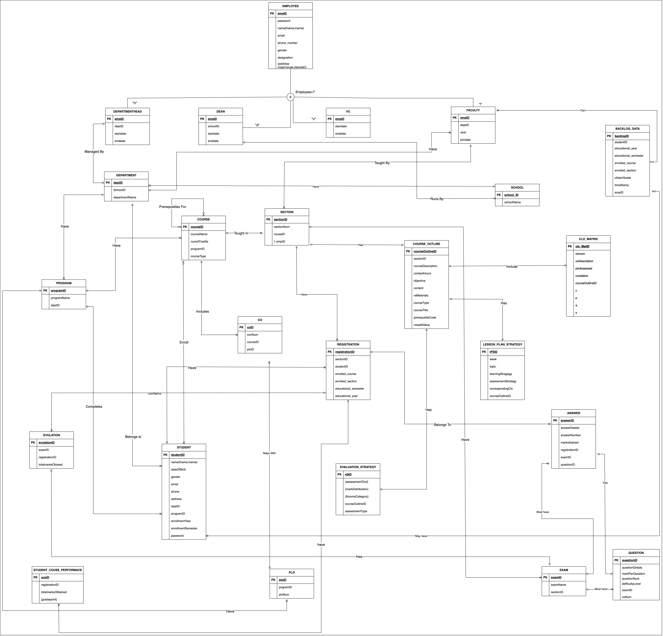
Entity Relationship Diagram
(ERD)

Slide 12
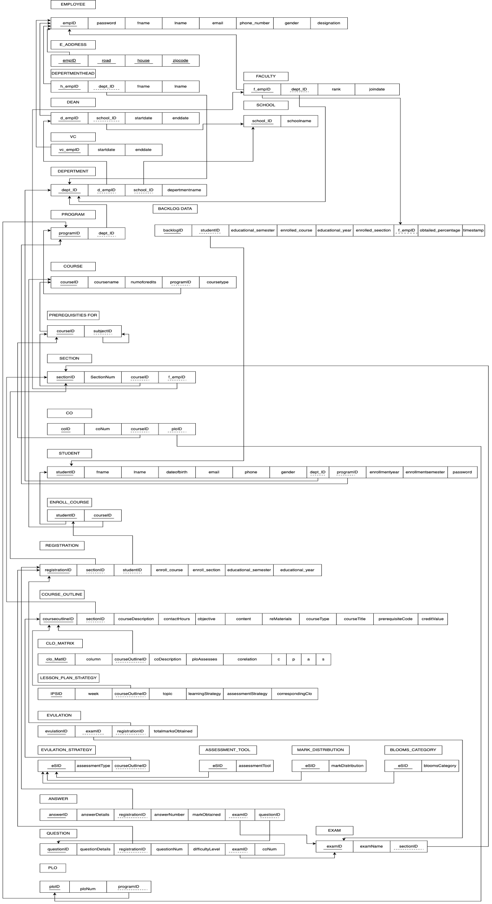
Relational
Schema

Slide 13
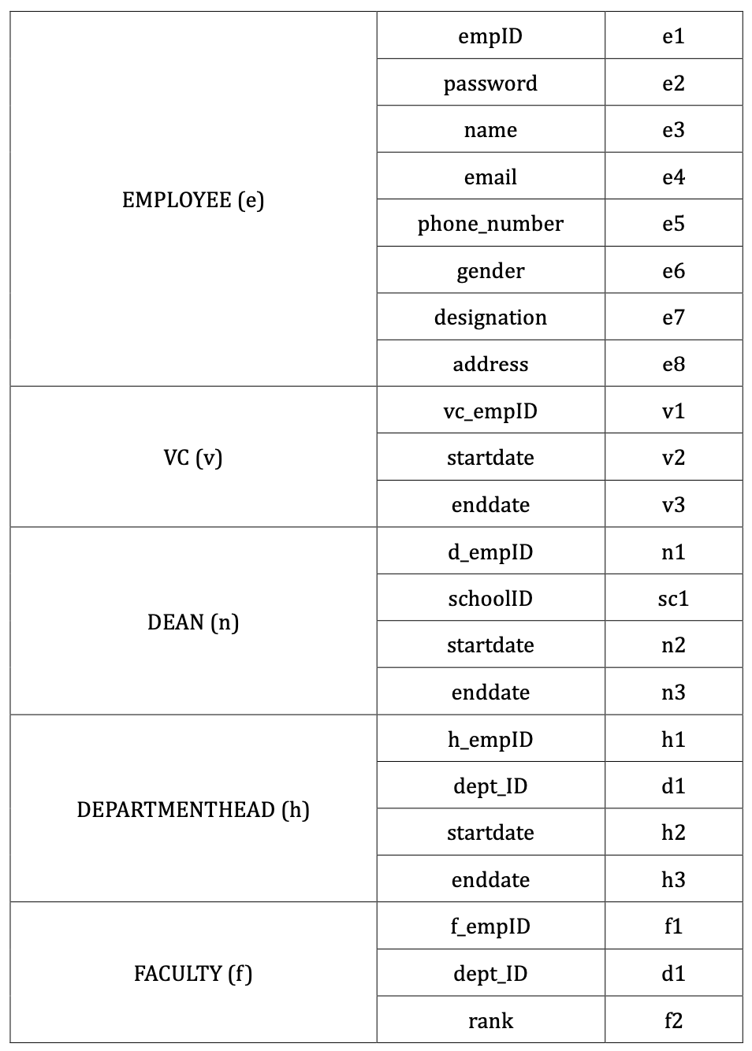
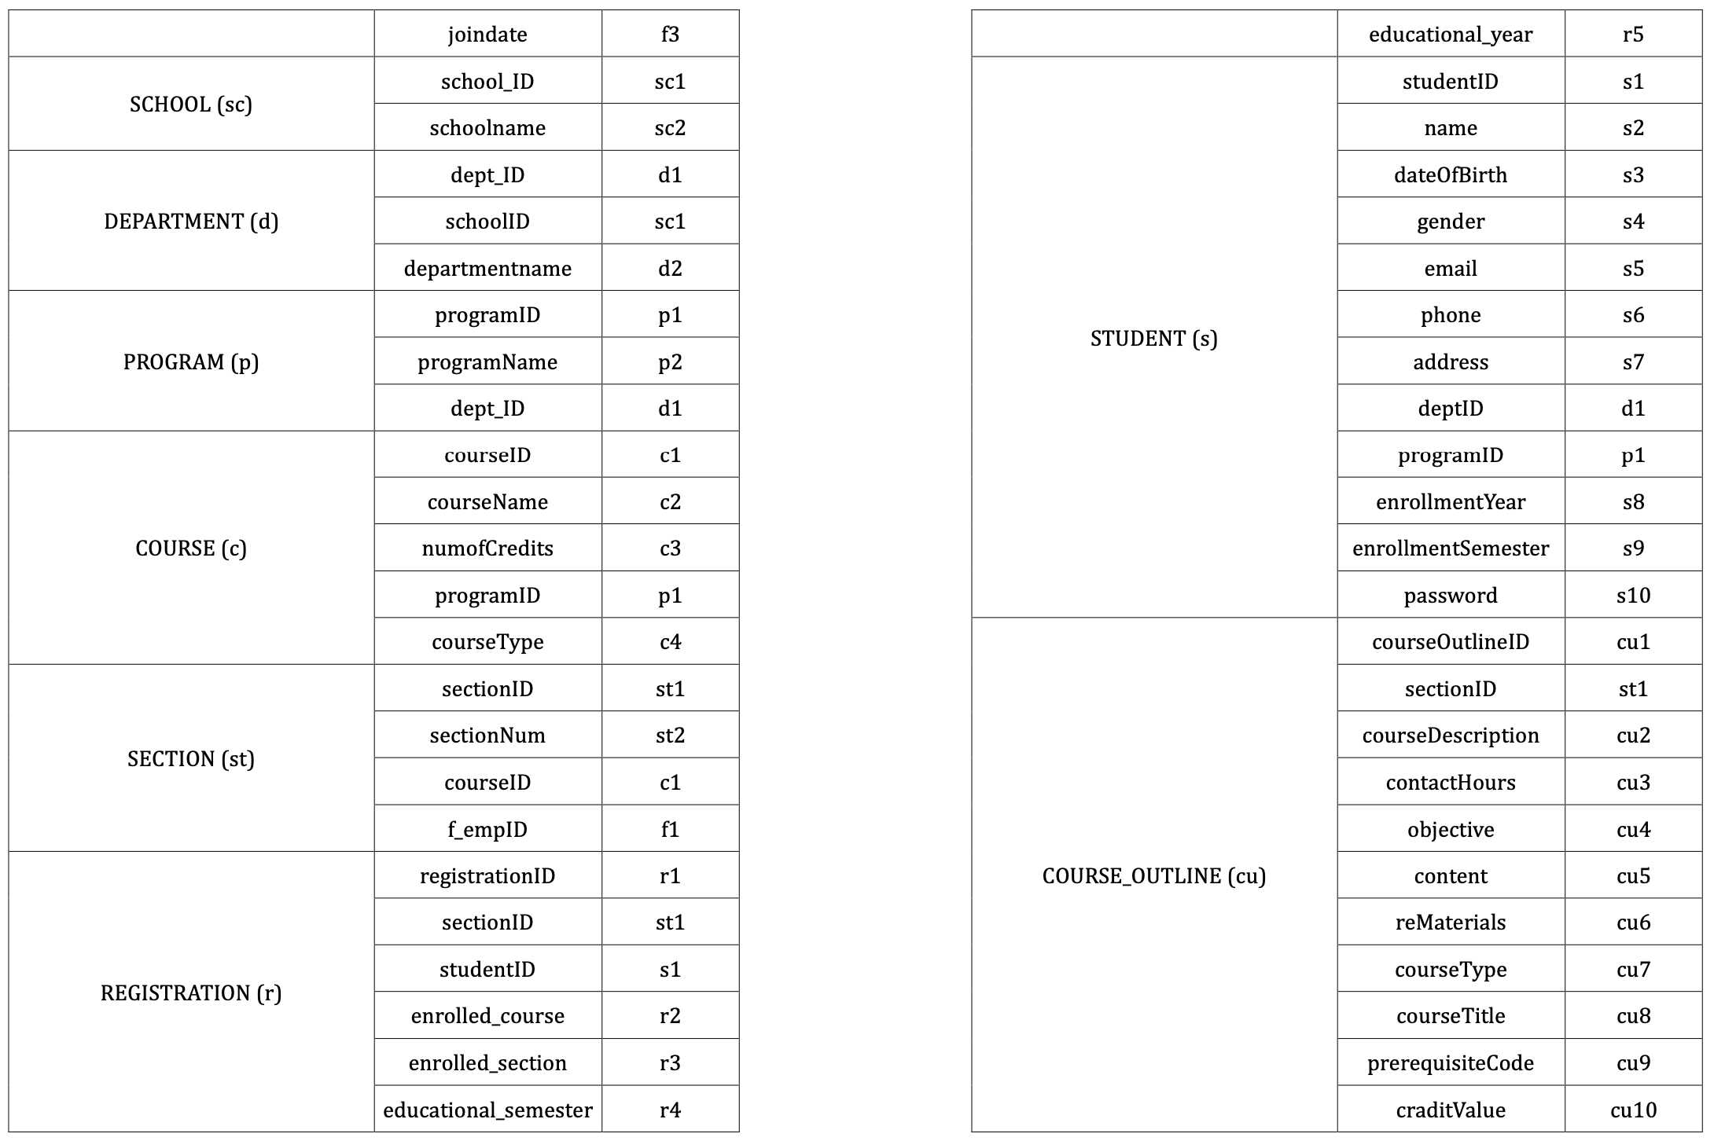
Normalization

Slide 14
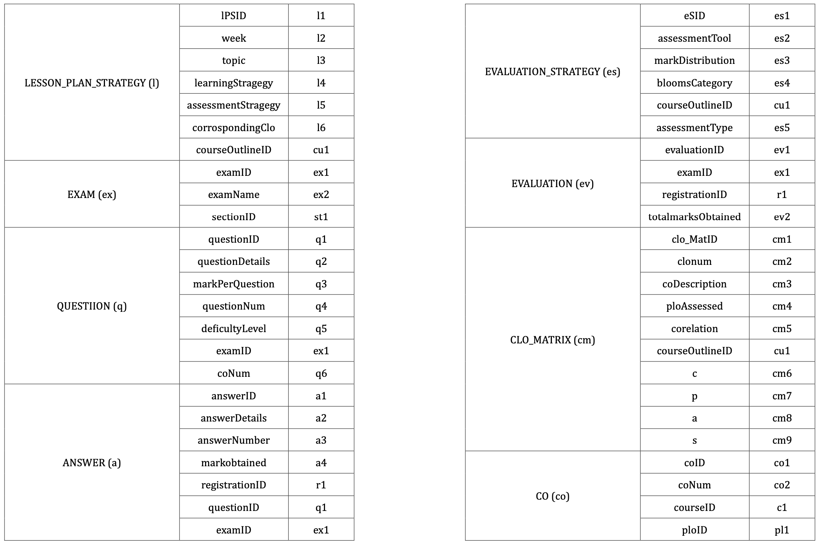

Slide 15
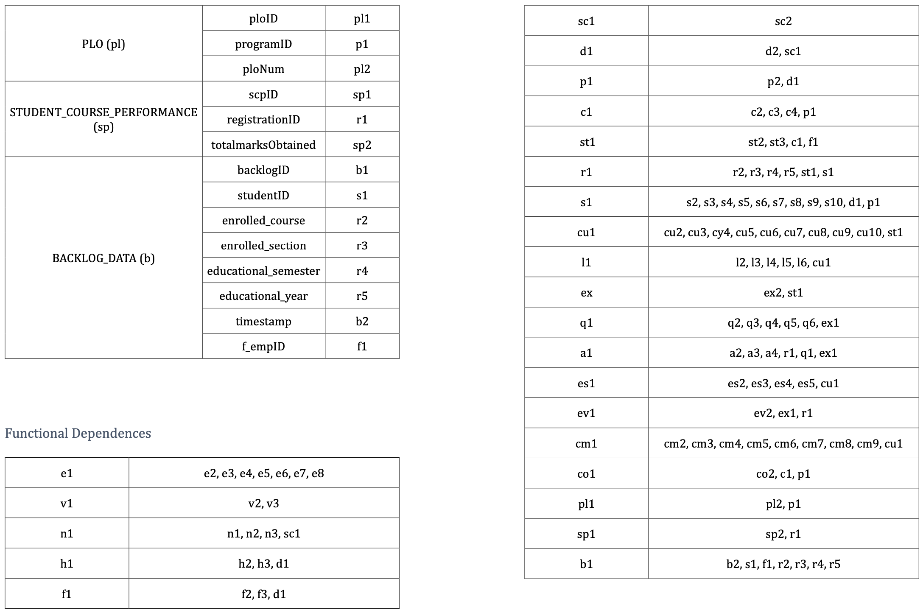

Slide 16
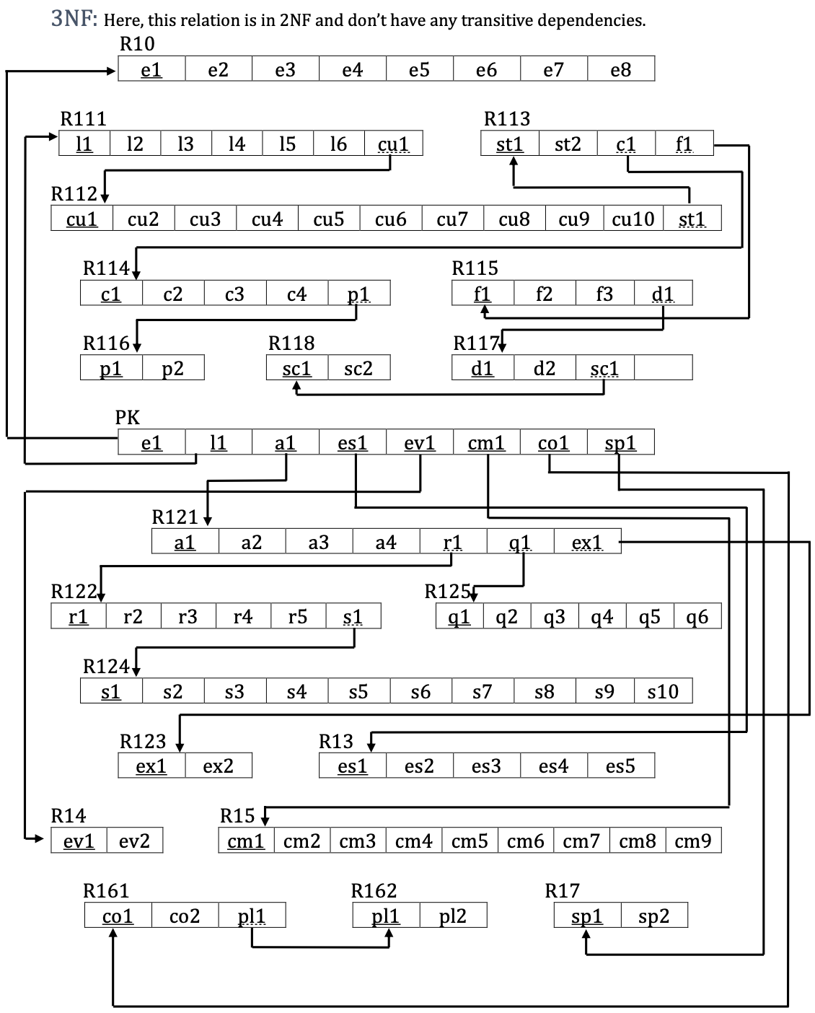
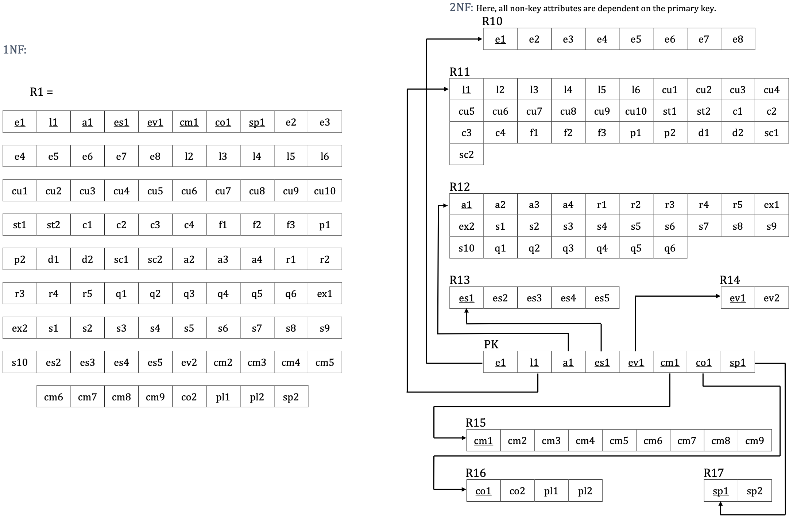

Slide 17
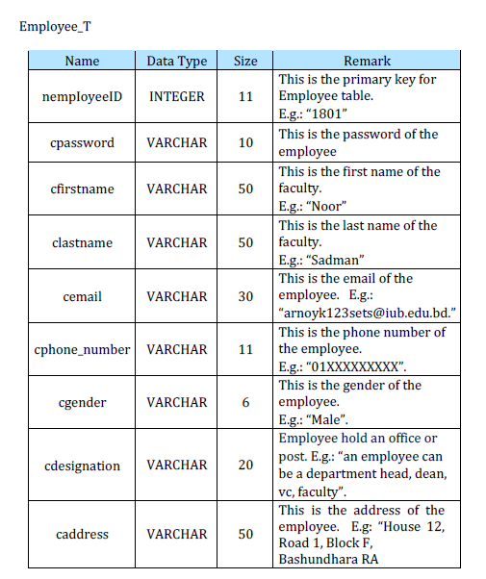
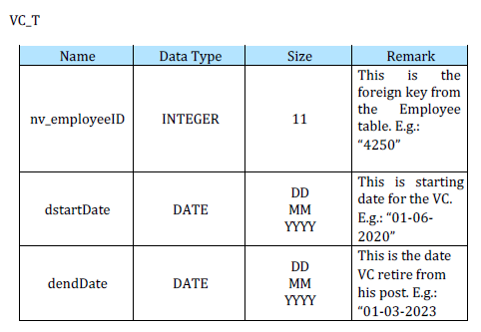
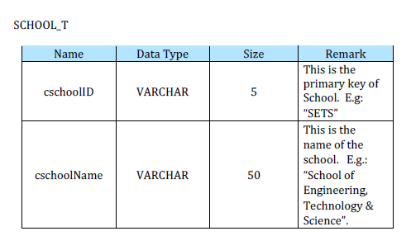
Data Dictionary

Slide 18
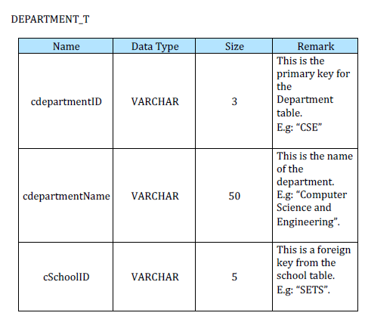
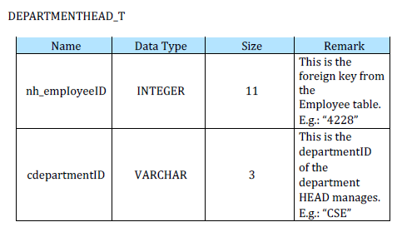
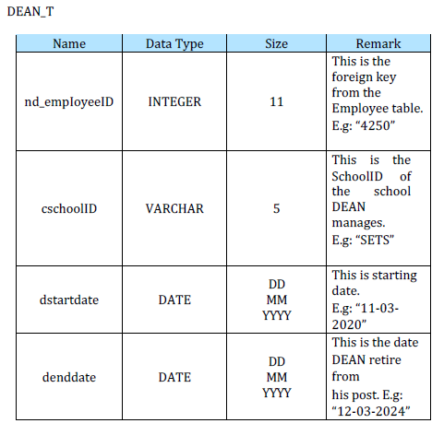
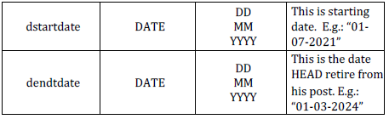
Data Dictionary cont.

Slide 19
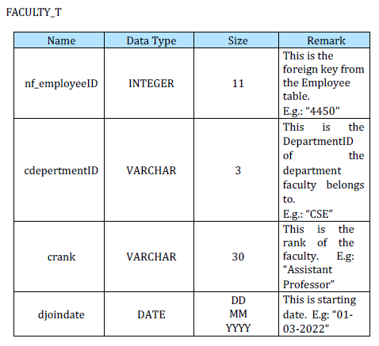
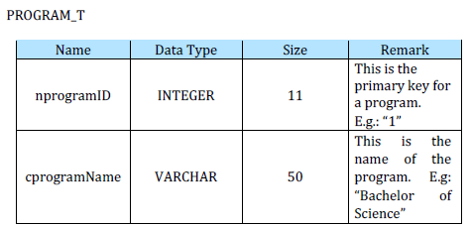
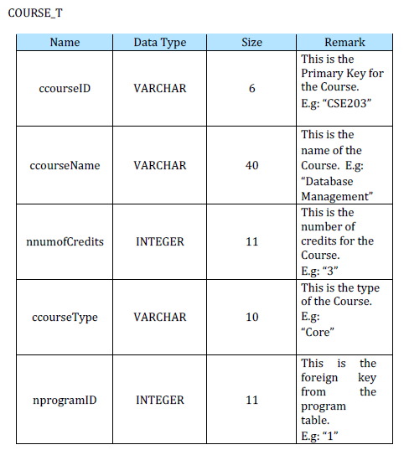
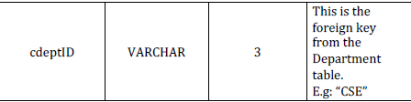
Data Dictionary cont.

Slide 20
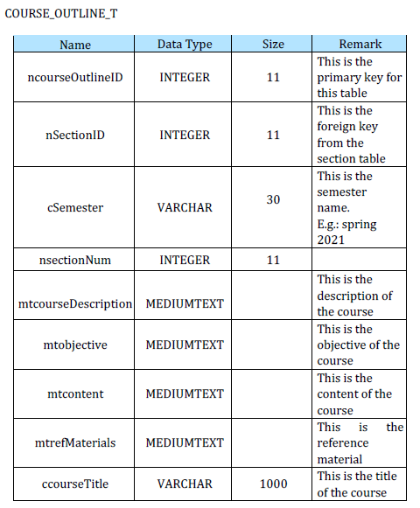
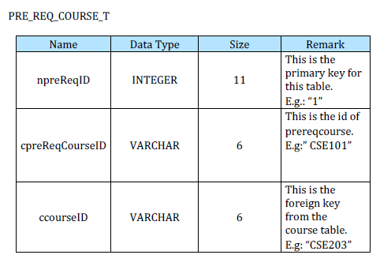
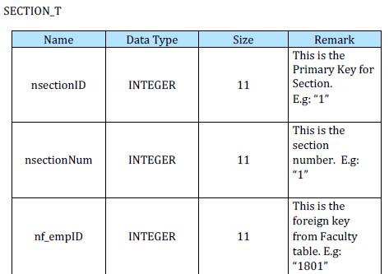
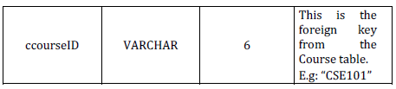
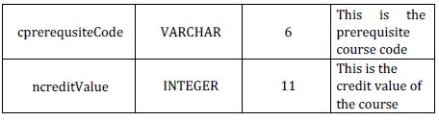
Data Dictionary cont.

Slide 21
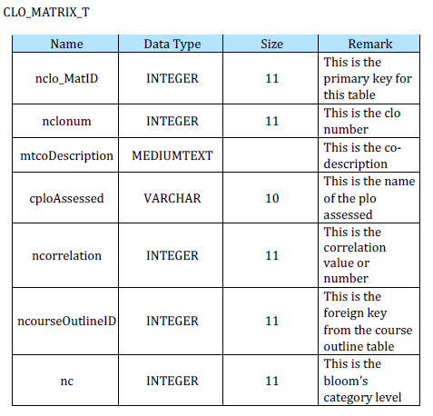
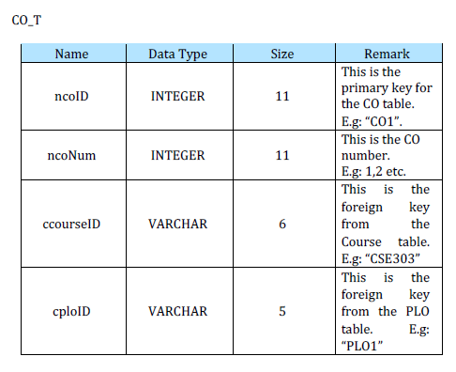
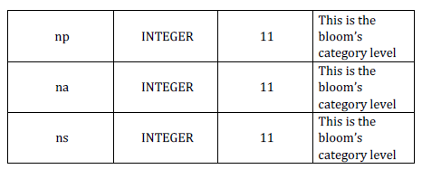
Data Dictionary cont.

Slide 22
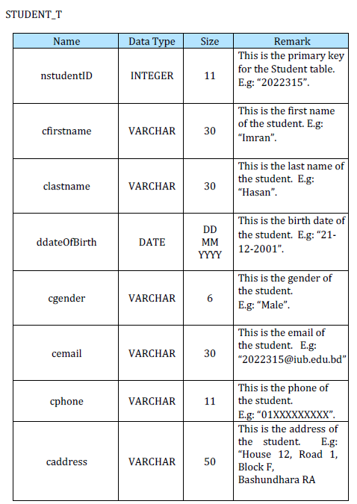
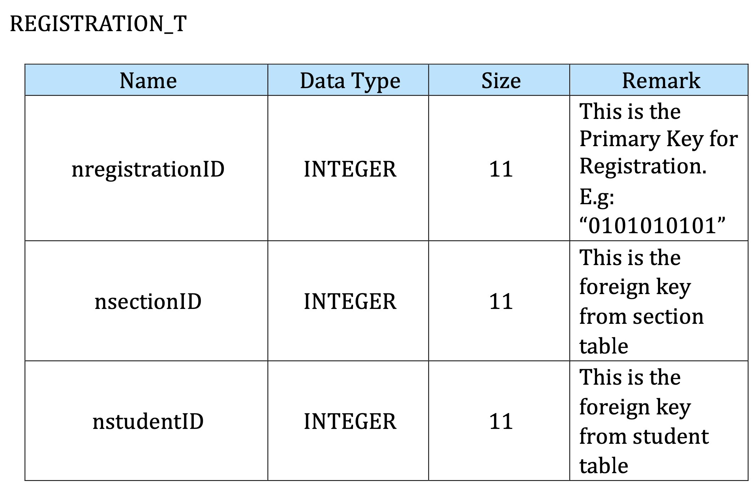
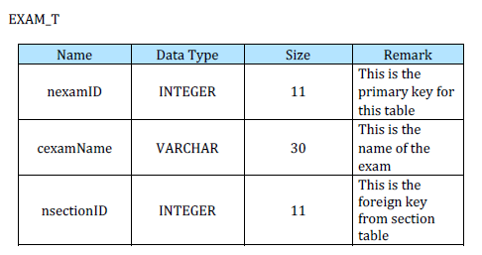
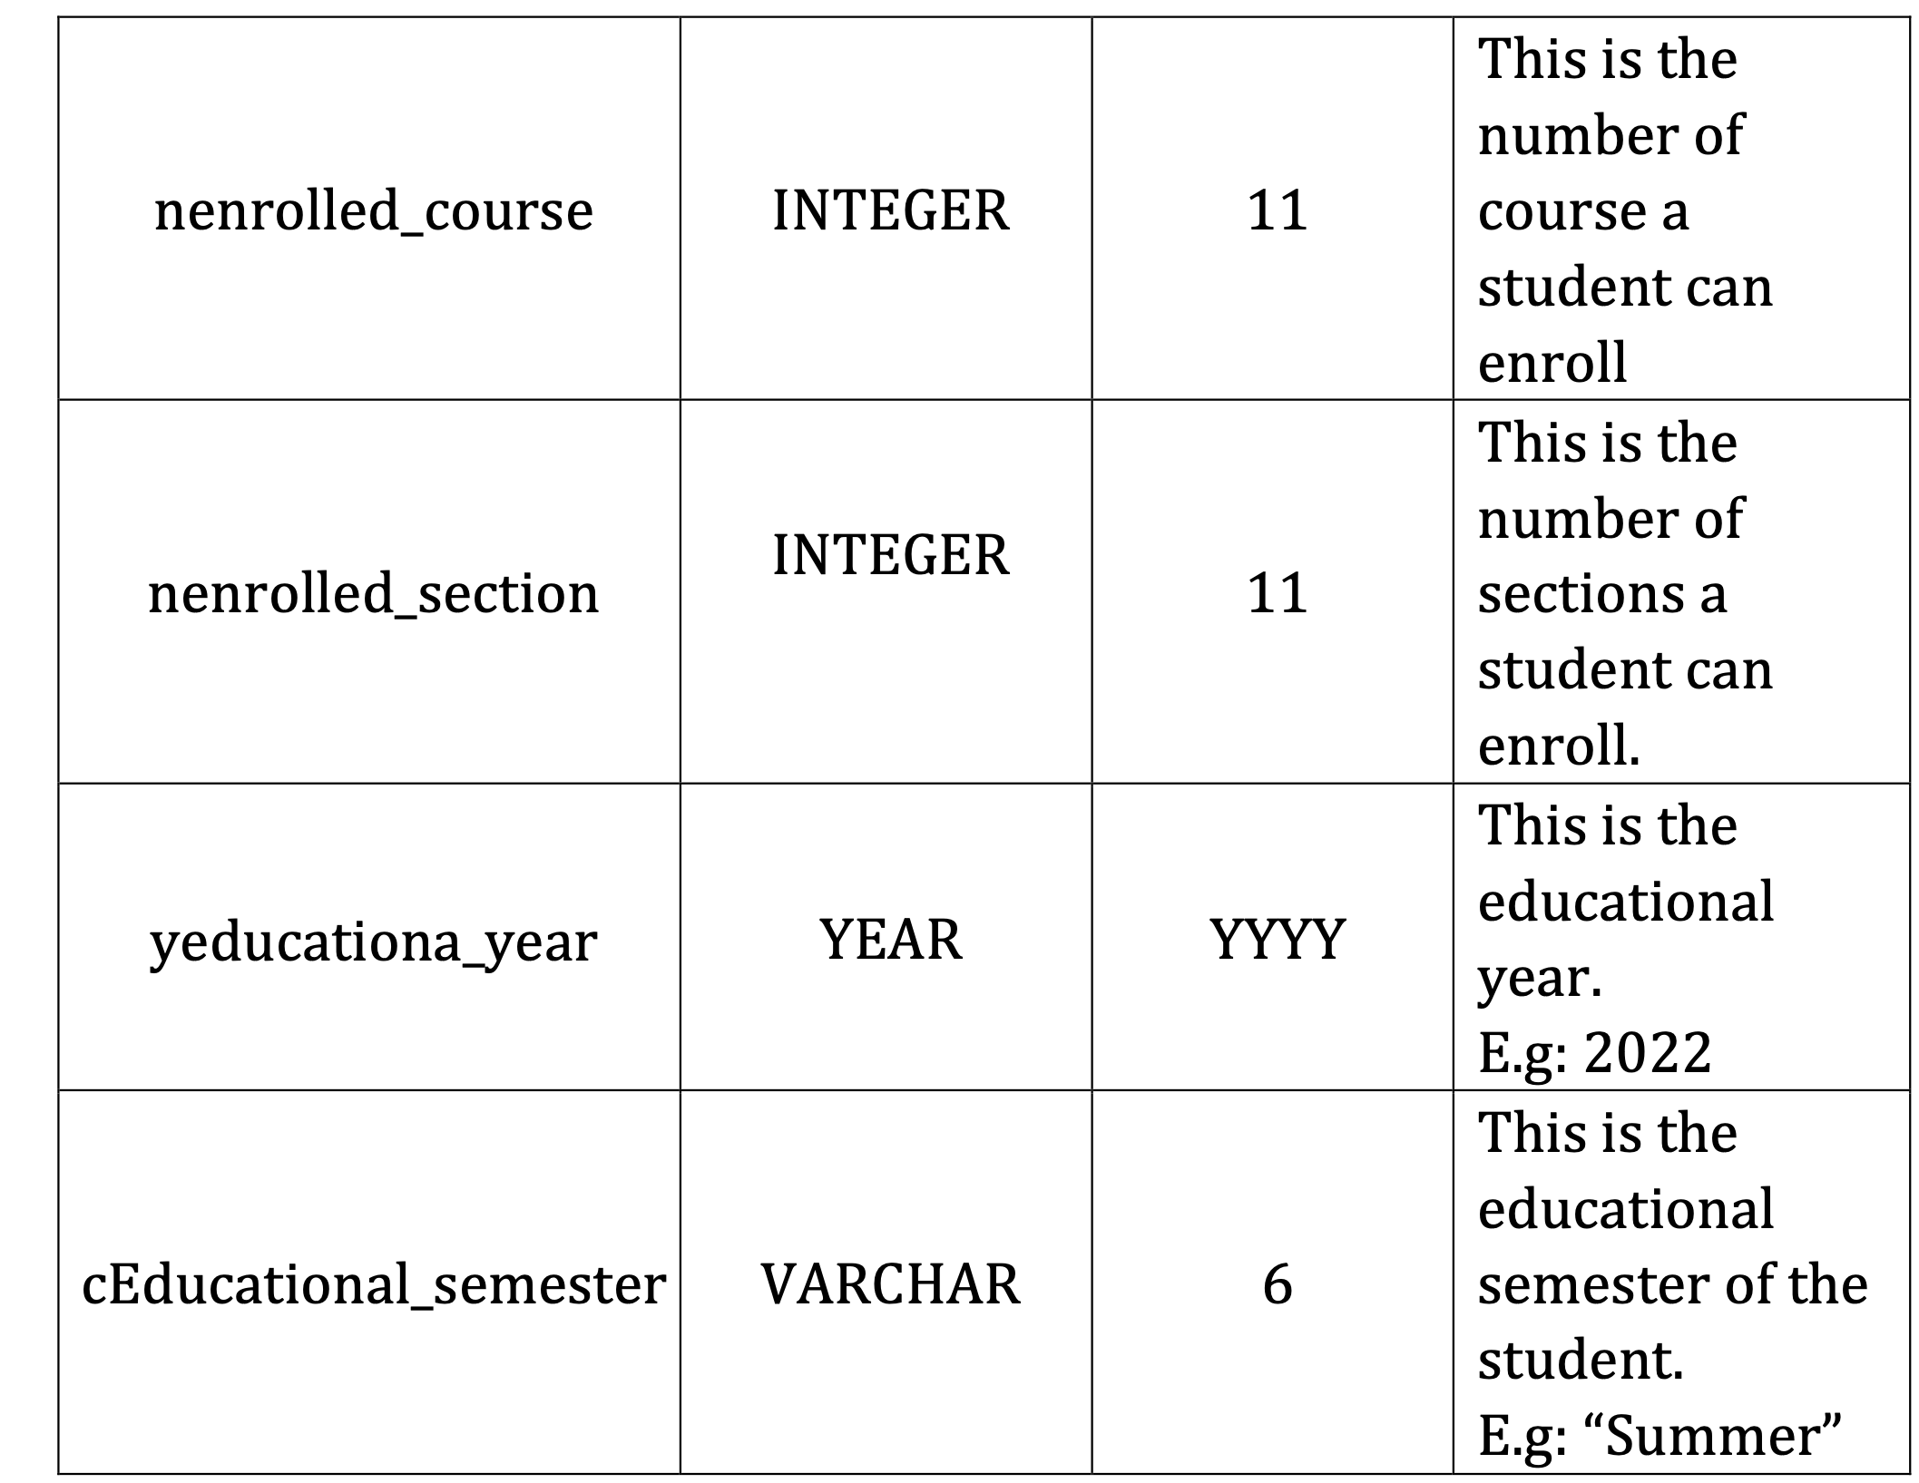
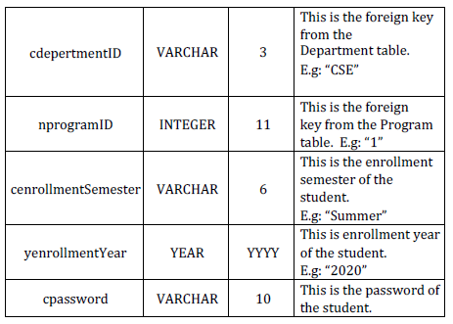
Data Dictionary cont.

Slide 23
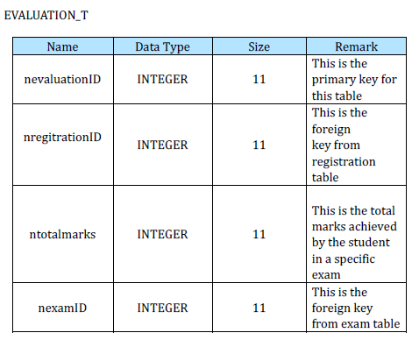
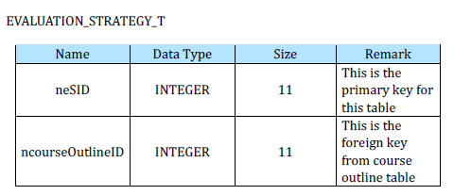
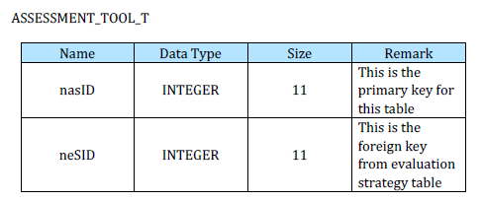
Data Dictionary cont.

Slide 24
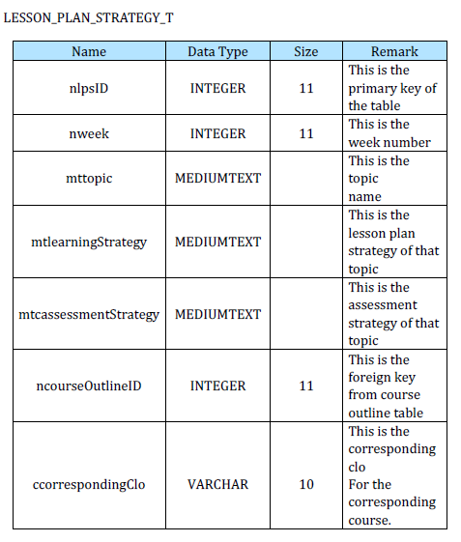
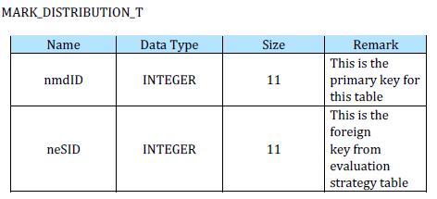
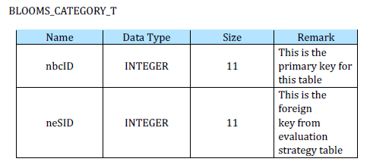
Data Dictionary cont.

Slide 25
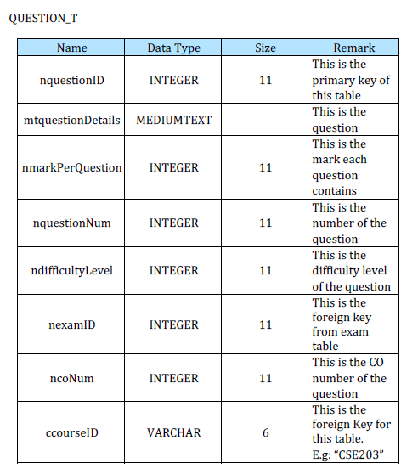
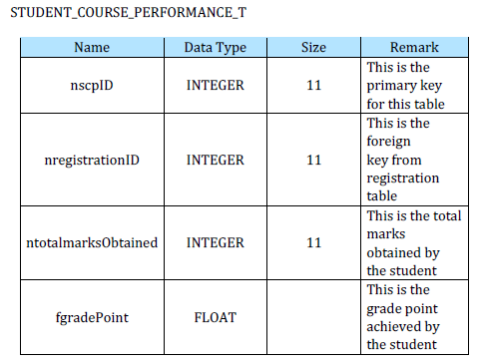
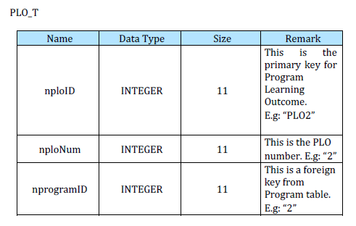
Data Dictionary cont.

Slide 26
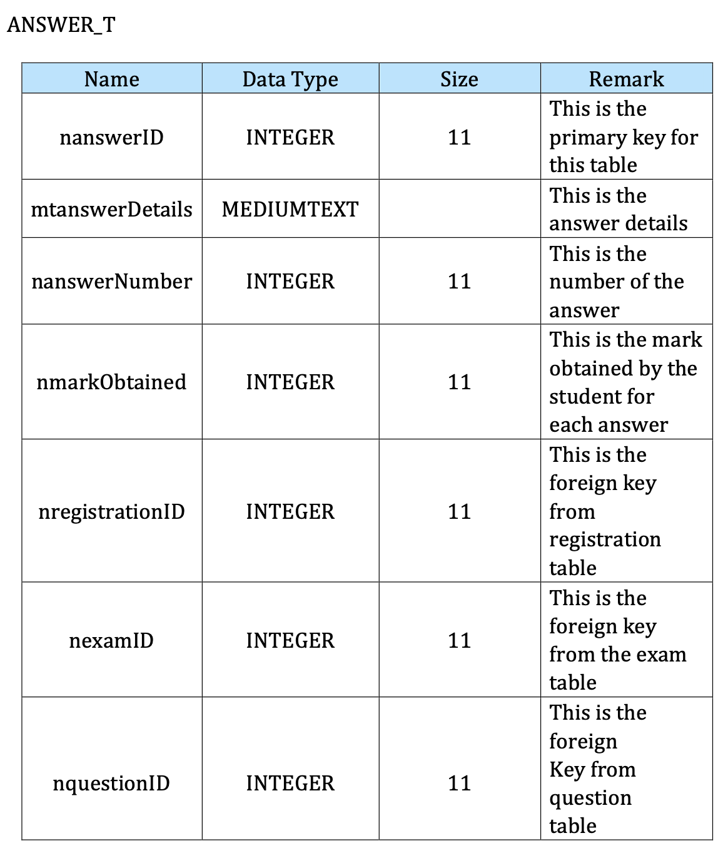
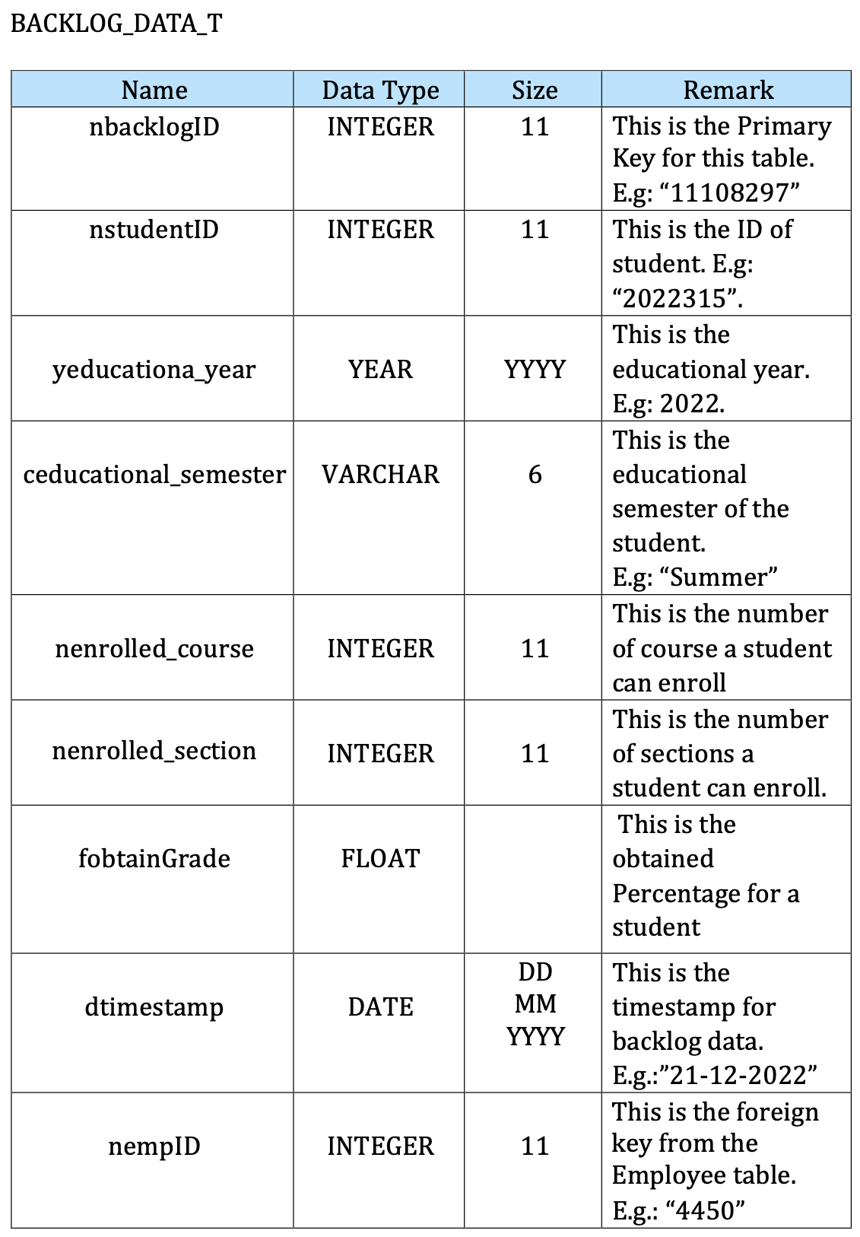
Data Dictionary cont.

Slide 27
Physical System Design

Slide 28
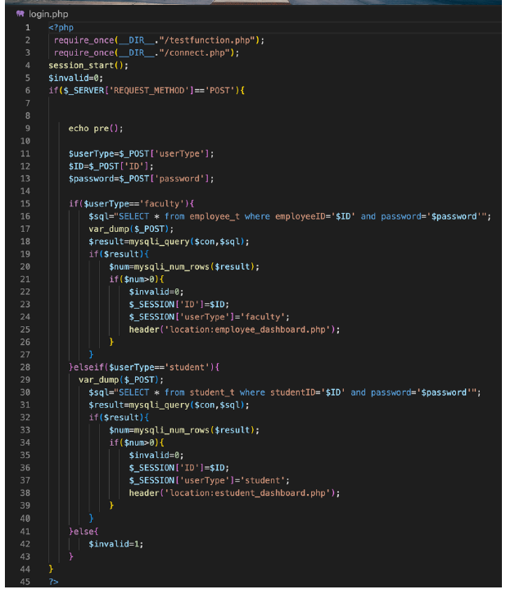
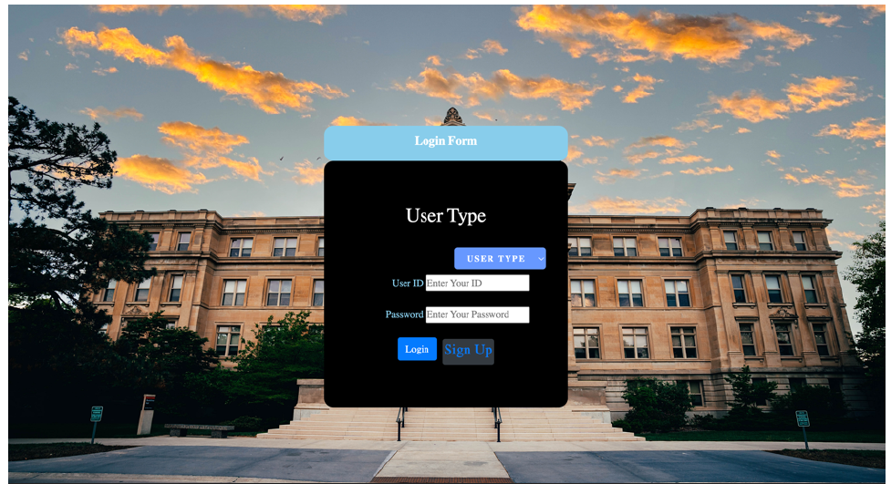
Input Forms

Slide 29
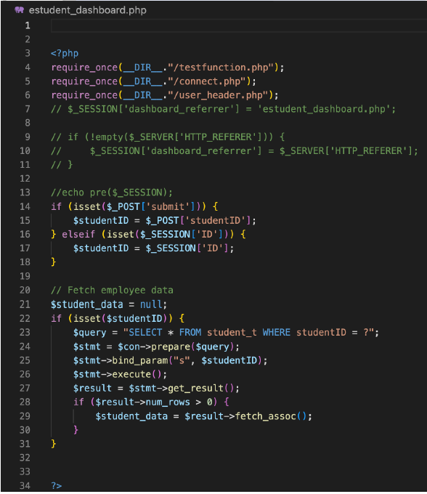
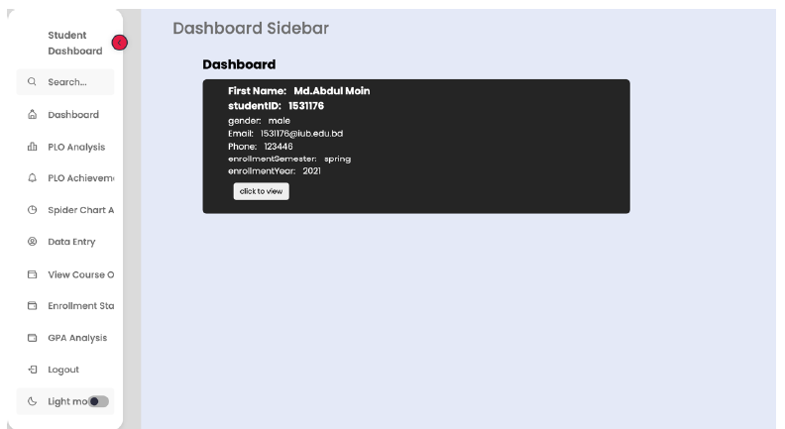
Input Forms cont.

Slide 30
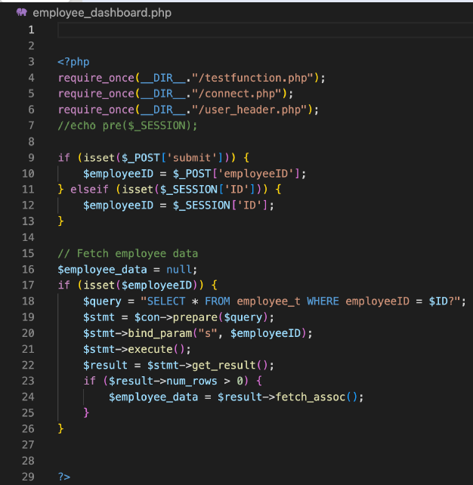

Input Forms cont.

Slide 31



Slide 32


Output Forms

Slide 33



Output Forms cont.

Slide 34


Output Forms cont.

Slide 35


Output Forms cont.

Slide 36
Conclusion
In conclusion, developing the SpmsV4 system posed several challenges throughout the analysis, design, and implementation phases. However, through collaboration with faculty members and stakeholders, we were able to overcome confusion around the system's operations, design challenges, and bugs. Moving forward, integrating extracurricular activity monitoring into the SpmsV4 system could enhance the system's functionality and provide invaluable insights into student engagement for teachers and administrators. To do so, it's important to consider secure data collection and storage, student privacy and consent, and intuitive data presentation. Ultimately, this new feature could help foster a more inclusive and supportive school environment and contribute to students' success both in and out of the classroom.

Slide 37
Thank you
For your time and attention!

